Slide 1

FLIGHT PRICE PREDICTION PROJECT
BY
Aaluri Krishnaveni Reddy

Slide 2
Problem Statement
This project aims to develop a model which will predict the flight prices for various flights using machine learning model. Flight ticket prices can be something hard to guess, today we might see a price, check out the price of the same flight tomorrow, it will be a different story. We might have often heard travelers saying that flight ticket prices are so unpredictable. Here you will be provided with prices of flight tickets for various airlines and various cities. Here we have data between the moths of March and June of 2019
Here we have train data and test data. Train the model with the train data and predict the price for the test data

Slide 3
FEATURES
Airline : The name of the airline.
Date_of_Journey : The date of the journey
Source : The source from which the service begins.
Destination : The destination where the service ends.
Route : The route taken by the flight to reach the destination.
Dep_Time : The time when the journey starts from the source.
Arrival_Time : Time of arrival at the destination.
Duration : Total duration of the flight.
Total_Stops : Total stops between the source and destination.
Additional_Info : Additional information about the flight
Price: The price of the ticket

Slide 4
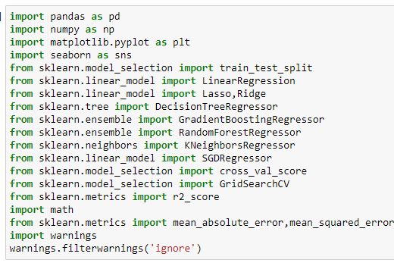
Importing important libraries
To use the functionality present in any module, you have to import it into your current program, we need to use the import keyword along with the desired module name. When interpreter comes across an import statement, it imports the module to your current program. We can use the functions inside a module by using a dot(.) operator along with the module name.

Slide 5
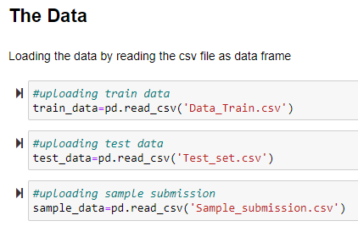
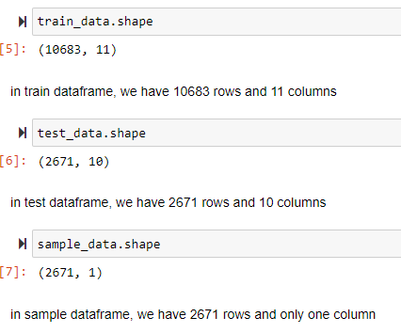
The Dataset & Dimension
Here we have 3 file in dataset, one is train data, test data, sample data
We have 10683 rows and 11 columns in train data
We have 2671 rows and 10 columns in test data
We have 2671 rows and 1 column in sample data

Slide 6
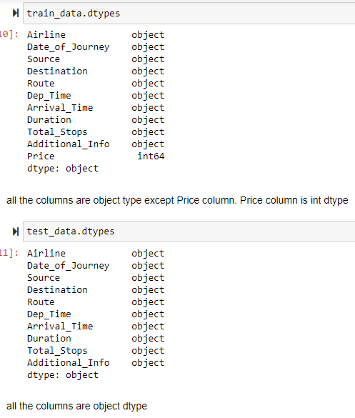
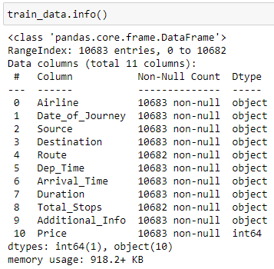
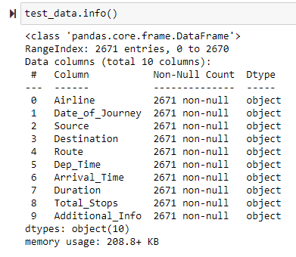
Datatype of columns and info of dataframe
all the columns are object type except Price column. Price column is int dtype in train dataset
all the columns are object dtype

Slide 7
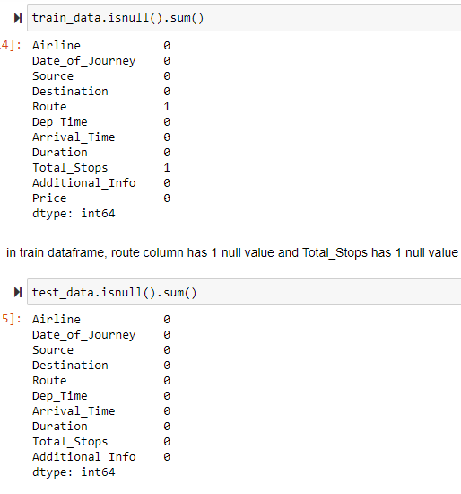
Null values
We have 2 null values in train data. One in Route column and Total_Stops has one null value
No null values in the test data

Slide 8
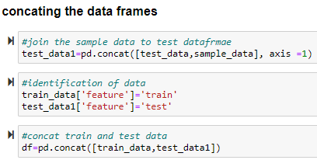
Concat the data frames
Concat the data frames to perform all the operations together for train data and test data
We have to predict the values for test data, we don’t have target value in the set so we have sample data

Slide 9
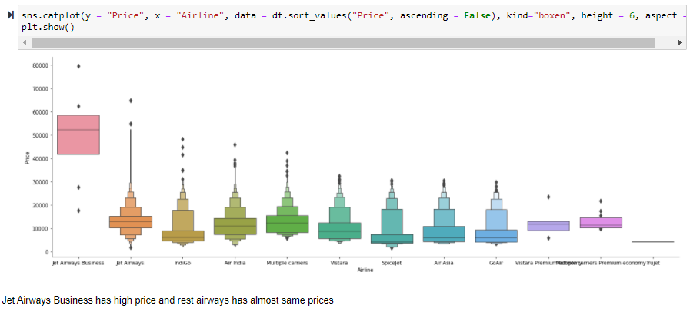
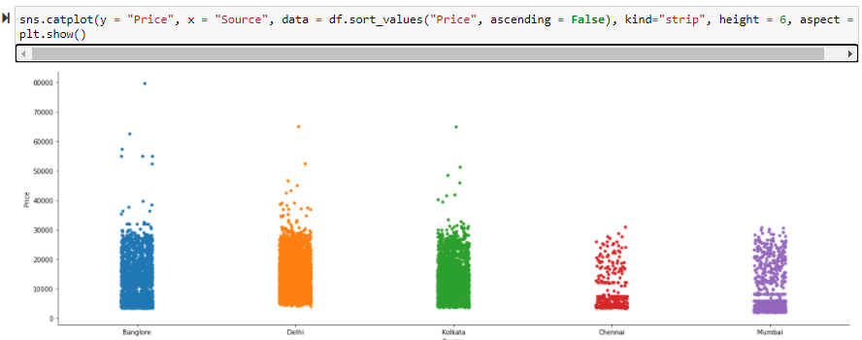
Jet Airways Business has high price and rest airways has almost same prices
Bangalore has high price and next Kolkata source has high prices and Chennai has less entries and compare with other source we have less price

Slide 10
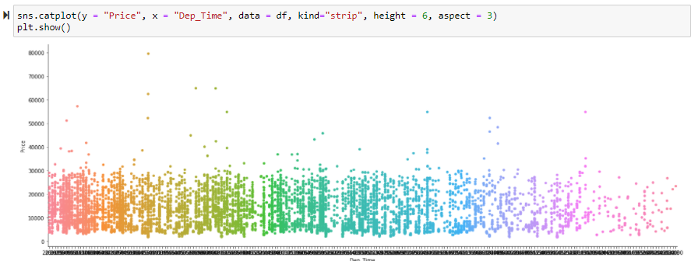
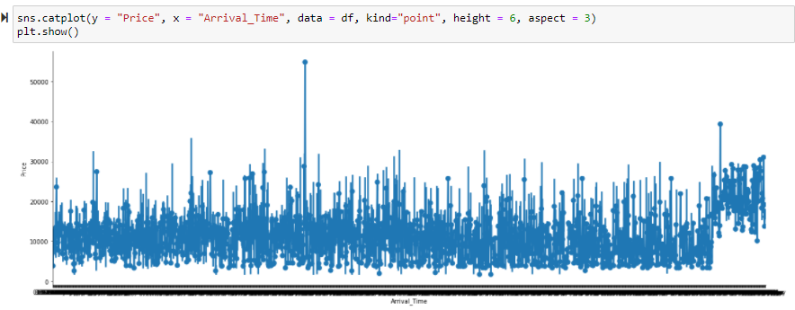
Plots are to show the timings of departure and arrival of the flights

Slide 11
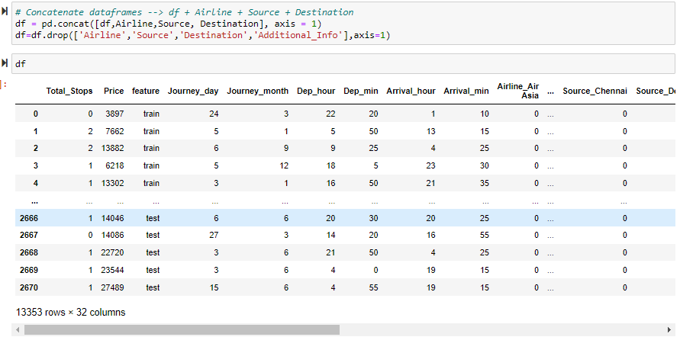
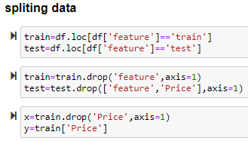
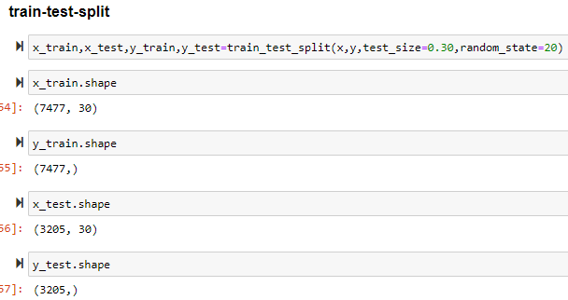
Preparing the data frame to train the model
Create dummy columns for Airline, Source, Destination columns
Drop the unnecessary columns
Split the data to dataframe into train and test data by the Source which we created when we concat
Split the target and features from the train data
And do apply train test split to train the models

Slide 12
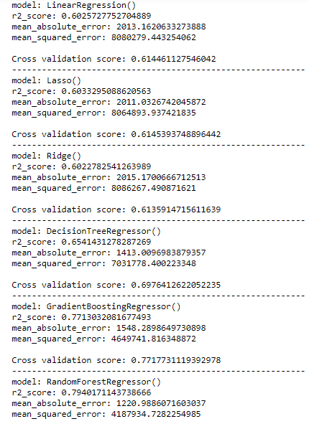
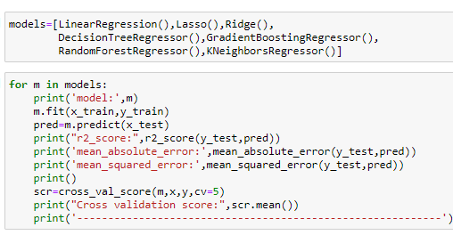
Machine Learning Algorithm
After applying the all the algorithms we can clearly see that GradientBoostingRegressor is the best algorithms

Slide 13
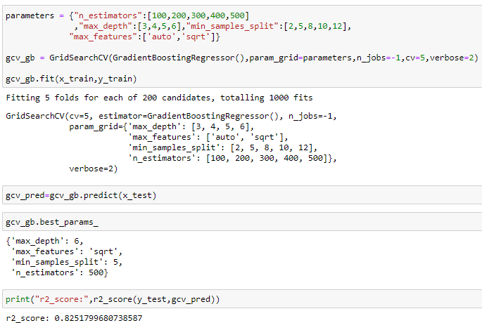
Hyper Parameter Tunning
After Hyper parameter tuning we can see the improvement of model
Before the hyper tuning we have 77% accurate
After hyper tuning we got 82.5% accurate

Slide 14
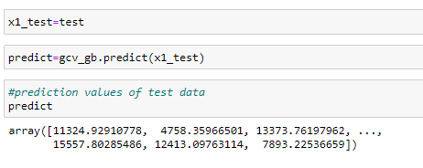
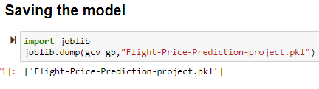
Predict the values for test data and save the model
Side picture show the code to predict the values for test dataframe with the model

Slide 15
Conclusion
Hence, at the end, we were successfully able to train our regression model ‘Gradient Boosting Regressor’ to predict the flights of prices with an r2_score of 82.5%, and have achieved the required task successfully.

